Slide 1
Systems Analysis and Design 11th Edition
Chapter 9 – Data Design
Copyright ©2017 Cengage Learning. All Rights Reserved. May not be scanned, copied or duplicated, or posted to a publicly accessible website, in whole or in part.

Slide 2
Chapter Objectives
Explain file-oriented systems and how they differ from database management systems
Explain data design terminology, including entities, fields, common fields, records, files, tables, and key fields
Describe data relationships, draw an entity- relationship diagram, define cardinality, and use cardinality notation
Copyright ©2017 Cengage Learning. All Rights Reserved. May not be scanned, copied or duplicated, or posted to a publicly accessible website, in whole or in part.

Slide 3
Chapter Objectives (Cont.)
Explain the concept of normalization
Explain the importance of codes and describe various coding schemes
Explain data warehousing and data mining
Differentiate between logical and physical storage and records
Explain data control measures
Copyright ©2017 Cengage Learning. All Rights Reserved. May not be scanned, copied or duplicated, or posted to a publicly accessible website, in whole or in part.

Slide 4
Data Design Concepts
Data Structures
Framework for organizing, storing, and managing data
Comprises of files or tables that interact in various ways
Each file or table contains data about people, places, things, or events
Copyright ©2017 Cengage Learning. All Rights Reserved. May not be scanned, copied or duplicated, or posted to a publicly accessible website, in whole or in part.

Slide 5
Data Design Concepts (Cont. 1)
Mario and Danica - A Data Design Example
Mario’s auto shop uses file-oriented systems
MECHANIC SYSTEM uses the MECHANIC file to store data about shop employees
JOB SYSTEM uses the JOB file to store data about work performed at the shop
Danica’s auto shop uses a relational model
SHOP OPERATIONS SYSTEM - Tables are linked by a common field named Mechanic No field
Copyright ©2017 Cengage Learning. All Rights Reserved. May not be scanned, copied or duplicated, or posted to a publicly accessible website, in whole or in part.

Slide 6
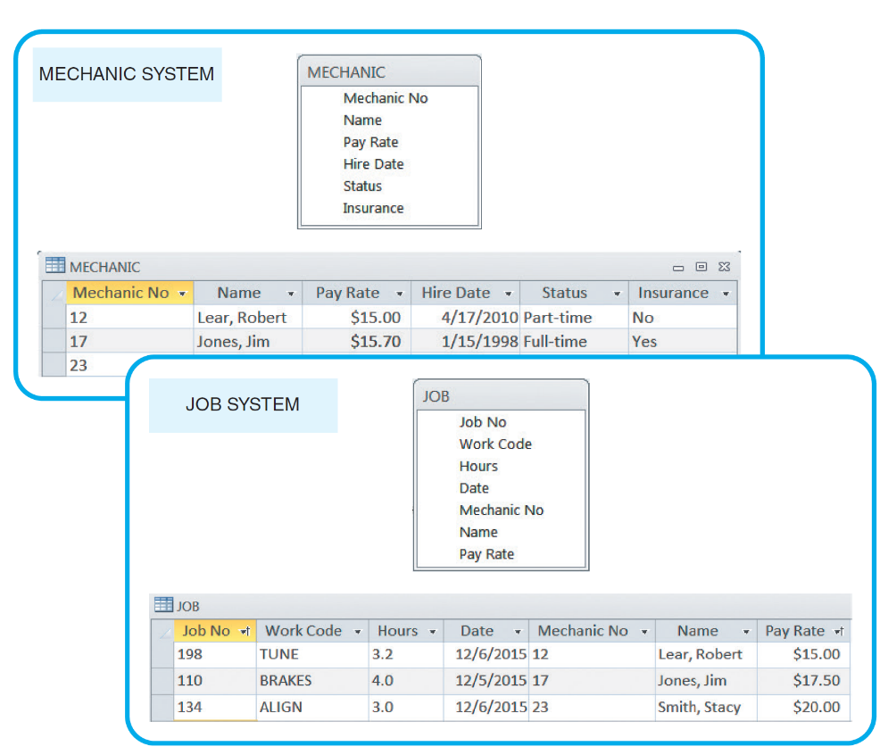
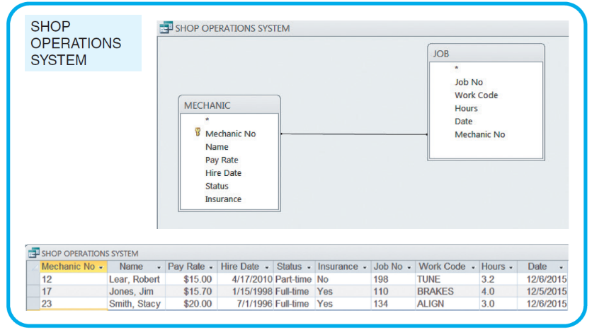
Data Design Concepts (Cont. 2)
Mario’s Auto Shop
Danica’s Auto Shop
FIGURE 9-4 Danica’s SHOP OPERATIONS SYSTEM uses a database design, which avoids duplication. The data can be viewed as if it were one large table, regardless of where the data is stored physically.
FIGURE 9-2 Mario’s shop uses two separate systems, so certain data must be entered twice. This redundancy is inefficient and can produce data errors.
Copyright ©2017 Cengage Learning. All Rights Reserved. May not be scanned, copied or duplicated, or posted to a publicly accessible website, in whole or in part.

Slide 7
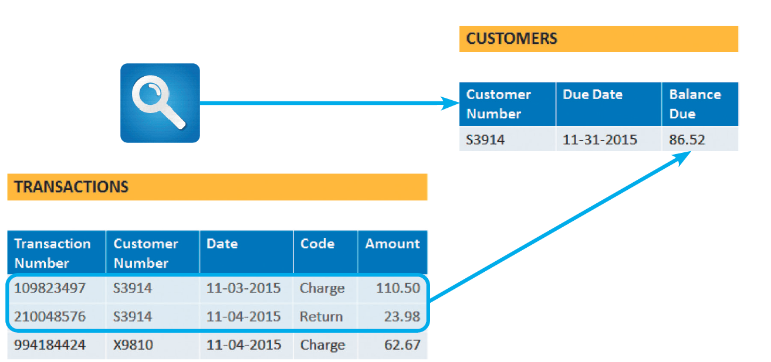
Data Design Concepts (Cont. 3)
Is File Processing Still Important?
Used by some companies to handle large volumes of structured data on a regular basis
Cost-effective in certain situations
FIGURE 9-4 A credit card company that posts thousands of daily transactions might consider a file processing option.
Copyright ©2017 Cengage Learning. All Rights Reserved. May not be scanned, copied or duplicated, or posted to a publicly accessible website, in whole or in part.

Slide 8
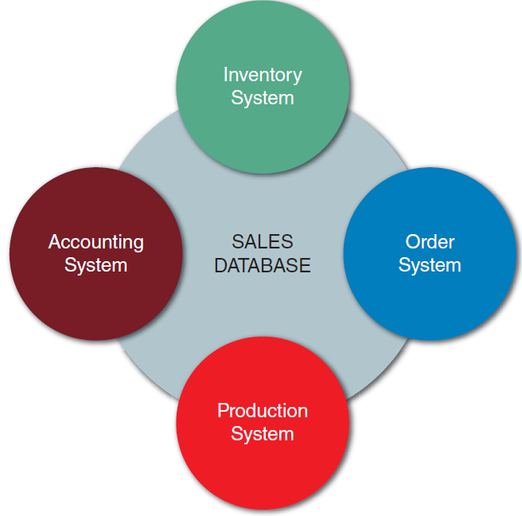
Data Design Concepts (Cont. 4)
The Database Environment
Database management system (DBMS): Collection of tools, features, and interfaces that enables users to add, update, manage, access, and analyze data
DBMS advantages
Scalability - System can be expanded, modified, or downsized
Economy of scale
Database design allows better utilization of hardware
Figure 9-5 In this example, a sales database can
support four separate business systems.
Copyright ©2017 Cengage Learning. All Rights Reserved. May not be scanned, copied or duplicated, or posted to a publicly accessible website, in whole or in part.

Slide 9
Data Design Concepts (Cont. 5)
Enterprise-wide application
A database administrator (DBA) assesses overall requirements and maintains the database
Stronger standards
Standards for data names, formats, and documentation are followed uniformly throughout the organization
Better security
Only legitimate users can access the database
Different users have different levels of access
Data independence
Systems that interact with a DBMS are relatively independent of how physical data is maintained
Copyright ©2017 Cengage Learning. All Rights Reserved. May not be scanned, copied or duplicated, or posted to a publicly accessible website, in whole or in part.

Slide 10
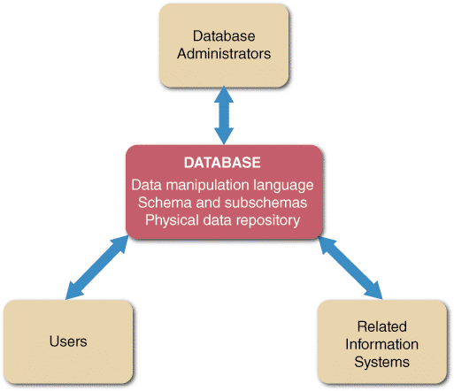
DBMS Components
Interfaces for Users, Database Administrators, and Related Systems
Users
Work with predefined queries and switchboard commands
Use query languages to access stored data
Database administrators
Responsible for DBMS
management and support
Related information systems
DBMS provides support to
related information systems
FIGURE 9-6 In addition to interfaces or users, database administrators, and related information systems, a DBMS also has a data manipulation language, a schema and subschemas, and a physical data repository.
Copyright ©2017 Cengage Learning. All Rights Reserved. May not be scanned, copied or duplicated, or posted to a publicly accessible website, in whole or in part.

Slide 11
DBMS Components (Cont.)
Data Manipulation Language (DML)
Controls database operations
Schema
Descriptions of all fields, tables, and relationships
Subschema: Portions of the database that a particular system or user needs or is allowed to access
Physical Data Repository
Contains the schema and subschemas
Can be centralized or distributed at several locations
Uses open database connectivity (ODBC)-compliant software that enables communication among the systems and DBMSs
Copyright ©2017 Cengage Learning. All Rights Reserved. May not be scanned, copied or duplicated, or posted to a publicly accessible website, in whole or in part.

Slide 12
Web-Based Data Design
Connecting to the Web
Databases are created and managed by using languages and commands that have nothing to do with HTML
Objective - To connect the database to the Web and enable data to be viewed and updated
Middleware is used integrate different applications and allow them to exchange data
Data Security
Web-based data must be secure, yet easily accessible to authorized users
Copyright ©2017 Cengage Learning. All Rights Reserved. May not be scanned, copied or duplicated, or posted to a publicly accessible website, in whole or in part.

Slide 13
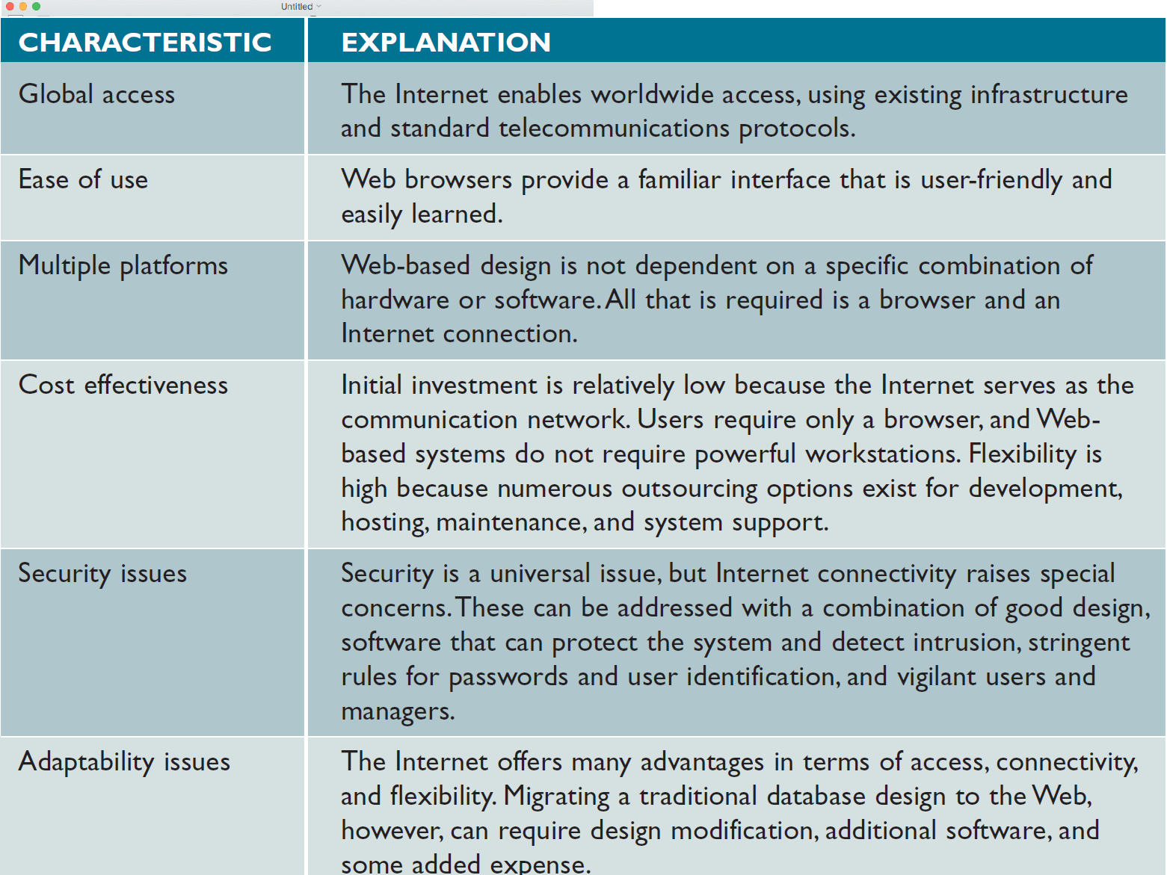
Web-Based Data Design (Cont. 1)
FIGURE 9-8 A Web-based design characteristics include global access, ease of use, multiple platforms, cost effectiveness, security issues, and adaptability issues. In a Web-based design, the Internet serves as the front end, or interface, for the database management system. Access to the database requires only a Web browser and an Internet connection.
Copyright ©2017 Cengage Learning. All Rights Reserved. May not be scanned, copied or duplicated, or posted to a publicly accessible website, in whole or in part.

Slide 14
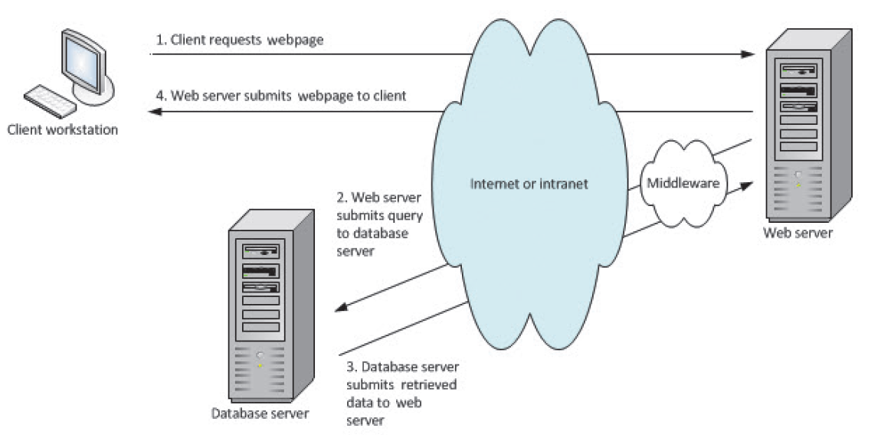
Web-Based Data Design (Cont. 2)
FIGURE 9-9 When a client workstation requests a Web page (1), the Web server uses middleware to generate a data query to the database server (2). The database server responds (3), and middleware translates the retrieved data into an HTML page that can be sent by the Web server and displayed by the user’s browser (4).
Copyright ©2017 Cengage Learning. All Rights Reserved. May not be scanned, copied or duplicated, or posted to a publicly accessible website, in whole or in part.

Slide 15
Data Design Terms
Definitions
Entity - Person, place, thing, or event for which data is collected and maintained
Table or file: Contains a set of related records that store data about a specific entity
Field (attribute) - Single characteristic or fact about an entity
Common field: Attribute that appears in more than one entity
Tuple (record): Set of related fields that describes one instance, or occurrence, of an entity
Copyright ©2017 Cengage Learning. All Rights Reserved. May not be scanned, copied or duplicated, or posted to a publicly accessible website, in whole or in part.

Slide 16
Data Design Terms (Cont. 1)
Key Fields
Primary key: Field or combination of fields that uniquely and minimally identifies a particular member of an entity
Called a combination key
Candidate key: Any field that could serve as a primary key
Foreign key: Field in one table that must match a primary key value in another table for a relationship between the two tables to exist
Secondary key: Field or combination of fields that can be used to access or retrieve records
Copyright ©2017 Cengage Learning. All Rights Reserved. May not be scanned, copied or duplicated, or posted to a publicly accessible website, in whole or in part.

Slide 17
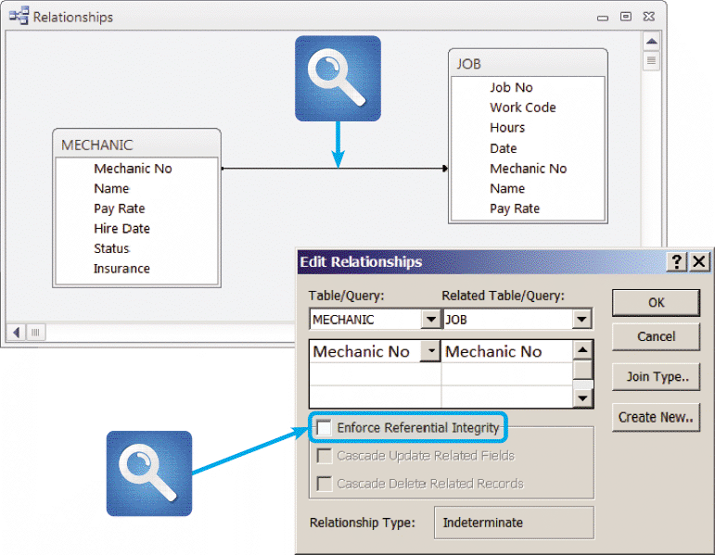
Data Design Terms (Cont. 2)
Referential Integrity
Set of rules that avoids data inconsistency and quality problems
FIGURE 9-11 Microsoft Access allows a user to specify that referential integrity rules will be enforced in a relational database design.
Copyright ©2017 Cengage Learning. All Rights Reserved. May not be scanned, copied or duplicated, or posted to a publicly accessible website, in whole or in part.

Slide 18
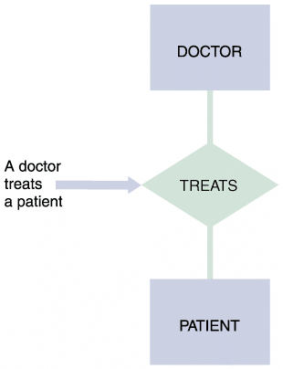
Entity-Relationship Diagrams
Drawing an ERD
List the entities that were identified during the systems analysis phase
Consider the nature of the relationships that link them
FIGURE 9-12 In an entity-relationship diagram, entities are labeled with singular nouns and relationships are labeled with verbs. The relationship is interpreted as a simple English sentence.
Copyright ©2017 Cengage Learning. All Rights Reserved. May not be scanned, copied or duplicated, or posted to a publicly accessible website, in whole or in part.

Slide 19
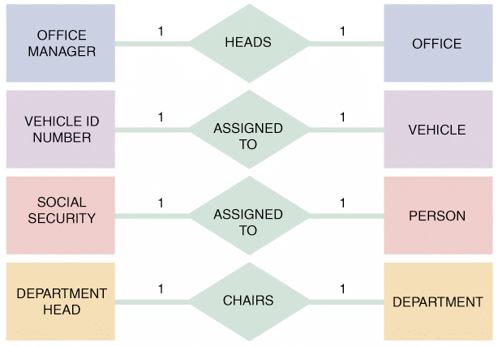
Entity-Relationship Diagrams (Cont. 1)
Types of Relationships
One-to-one relationship: Exists when exactly one of the second entity occurs for each instance of the first entity
Abbreviated 1:1
FIGURE 9-13 Examples of one-to-one (1:1) relationships.
Copyright ©2017 Cengage Learning. All Rights Reserved. May not be scanned, copied or duplicated, or posted to a publicly accessible website, in whole or in part.

Slide 20
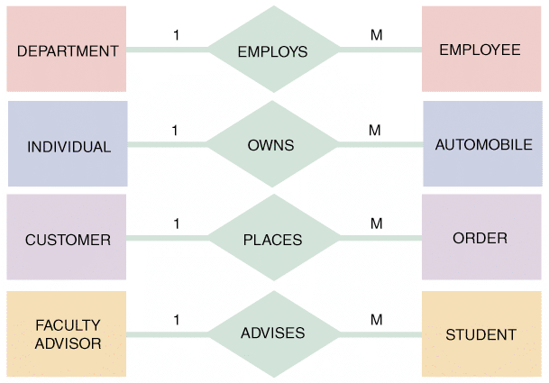
Entity-Relationship Diagrams (Cont. 2)
One-to-many relationship: Exists when one occurrence of the first entity can relate to many instances of the second entity
Each instance of the second entity can associate with only one instance of the first entity
Abbreviated 1:M
FIGURE 9-14 Examples of one-to-many (1:M) relationships.
Copyright ©2017 Cengage Learning. All Rights Reserved. May not be scanned, copied or duplicated, or posted to a publicly accessible website, in whole or in part.

Slide 21
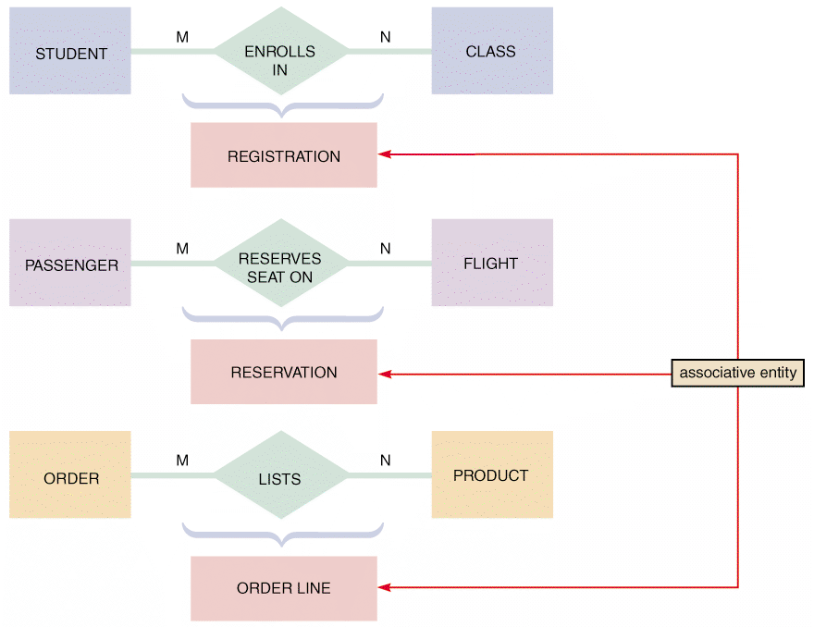
Entity-Relationship Diagrams (Cont. 3)
Many-to-many relationship
Exists when one instance of the first entity can relate to many instances of the second entity, and vice versa
Abbreviated M:N
FIGURE 9-15 Examples of many-to-many (M:N) relationships. Notice that the event or transaction that links the two entities is an associative entity with its own set of attributes and characteristics
Copyright ©2017 Cengage Learning. All Rights Reserved. May not be scanned, copied or duplicated, or posted to a publicly accessible website, in whole or in part.

Slide 22
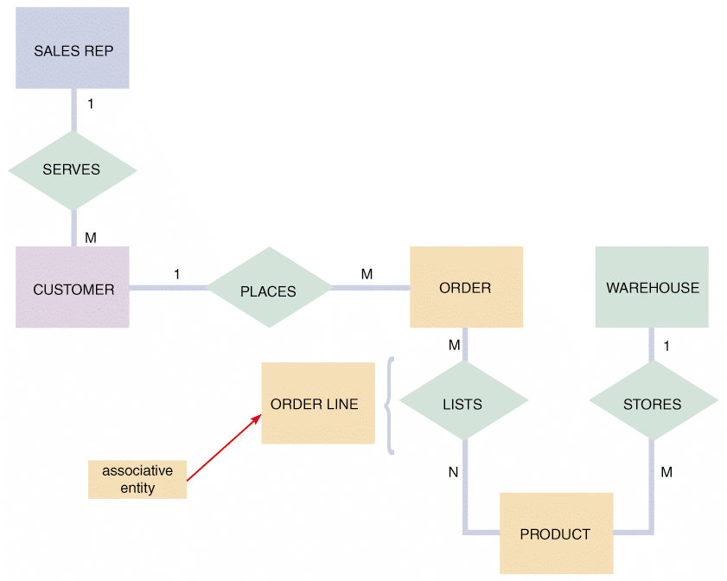
Entity-Relationship Diagrams (Cont. 4)
FIGURE 9-16 An entity-relationship diagram for SALES REP, CUSTOMER, ORDER, PRODUCT, and WAREHOUSE. Notice that the ORDER and PRODUCT entities are joined by an associative entity named ORDER LINE.
Copyright ©2017 Cengage Learning. All Rights Reserved. May not be scanned, copied or duplicated, or posted to a publicly accessible website, in whole or in part.

Slide 23
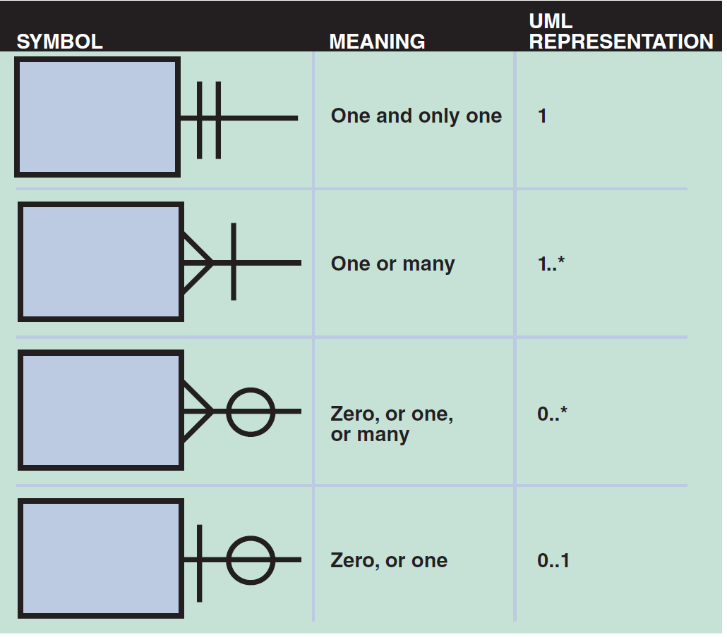
Entity-Relationship Diagrams (Cont. 5)
Cardinality
Describes the numeric relationship between two entities
Shows how instances of one entity relate to instances of another entity
Crow’s foot notation indicates various possibilities using circles, bars, and symbols
FIGURE 9-17 Crow’s foot notation is a common method of indicating cardinality. The four examples show how you can use various symbols to describe the relationships between entities.
Copyright ©2017 Cengage Learning. All Rights Reserved. May not be scanned, copied or duplicated, or posted to a publicly accessible website, in whole or in part.

Slide 24
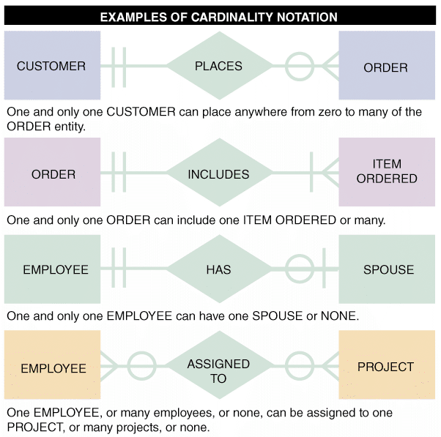
Entity-Relationship Diagrams (Cont. 6)
FIGURE 9-18 In the first example of cardinality notation, one and only one CUSTOMER can place anywhere from zero to many of the ORDER entity. In the second example, one and only one ORDER can include one ITEM ORDERED or many. In the third example, one and only one EMPLOYEE can have one SPOUSE or none. In the fourth example, one EMPLOYEE, or many employees, or none, can be assigned to one PROJECT, or many projects, or none.
Copyright ©2017 Cengage Learning. All Rights Reserved. May not be scanned, copied or duplicated, or posted to a publicly accessible website, in whole or in part.

Slide 25
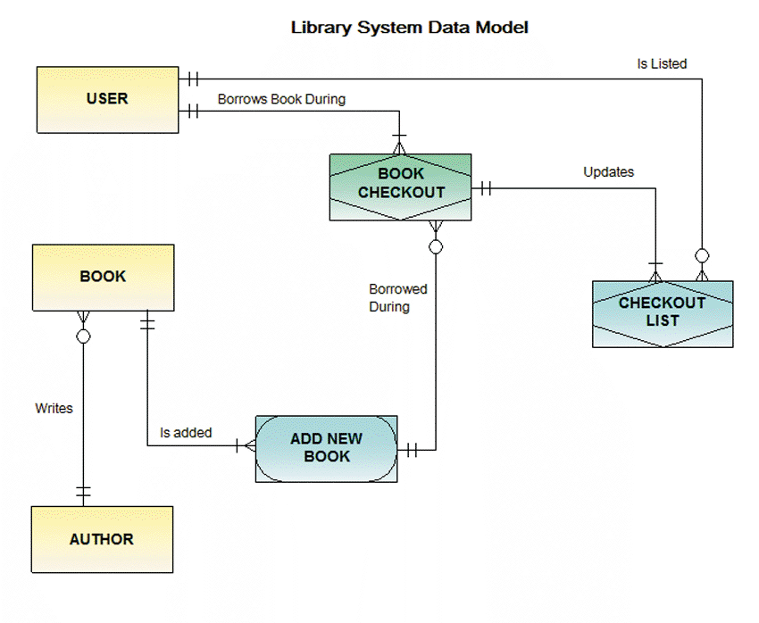
Entity-Relationship Diagrams (Cont. 7)
FIGURE 9-19 An ERD for a library system drawn with Visible Analyst. Notice that crow’s foot notation has been used and relationships are described in both directions.
Copyright ©2017 Cengage Learning. All Rights Reserved. May not be scanned, copied or duplicated, or posted to a publicly accessible website, in whole or in part.

Slide 26
Data Normalization
Normalization: Process of creating table designs by assigning specific fields or attributes to each table in the database
Table design: Specifies fields
Identifies the primary key in a particular table or file
Stages in a normalization process
Unnormalized design
First normal form
Second normal form
Third normal form
Copyright ©2017 Cengage Learning. All Rights Reserved. May not be scanned, copied or duplicated, or posted to a publicly accessible website, in whole or in part.

Slide 27
Data Normalization (Cont. 1)
Standard Notation Format
Used to show a table’s structure, fields, and primary key
The primary key field(s) is underlined
NAME (FIELD 1, FIELD 2, FIELD 3)
Recognition of repeating group fields is important
Repeating group: Set of one or more fields that can occur any number of times in a single record
Each occurrence would possess different values
Copyright ©2017 Cengage Learning. All Rights Reserved. May not be scanned, copied or duplicated, or posted to a publicly accessible website, in whole or in part.

Slide 28
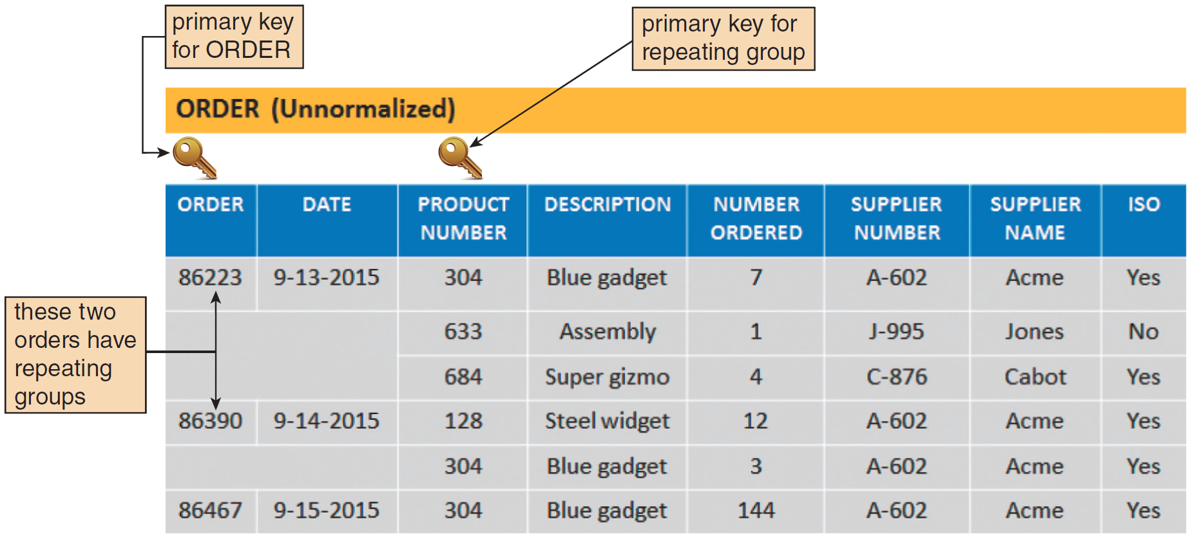
Data Normalization (Cont. 2)
FIGURE 9-20 In the ORDER table design, two orders have repeating groups that contain several products. ORDER is the primary key for the ORDER table, and PRODUCT NUMBER serves as a primary key for the repeating group. Because it contains repeating groups, the ORDER table is unnormalized.
Copyright ©2017 Cengage Learning. All Rights Reserved. May not be scanned, copied or duplicated, or posted to a publicly accessible website, in whole or in part.

Slide 29
Data Normalization (Cont. 3)
First Normal Form (1NF)
Does not contain a repeating group
Converting an unnormalized design to 1NF requires expansion of the table’s primary key to include the primary key of the repeating group
Copyright ©2017 Cengage Learning. All Rights Reserved. May not be scanned, copied or duplicated, or posted to a publicly accessible website, in whole or in part.

Slide 30
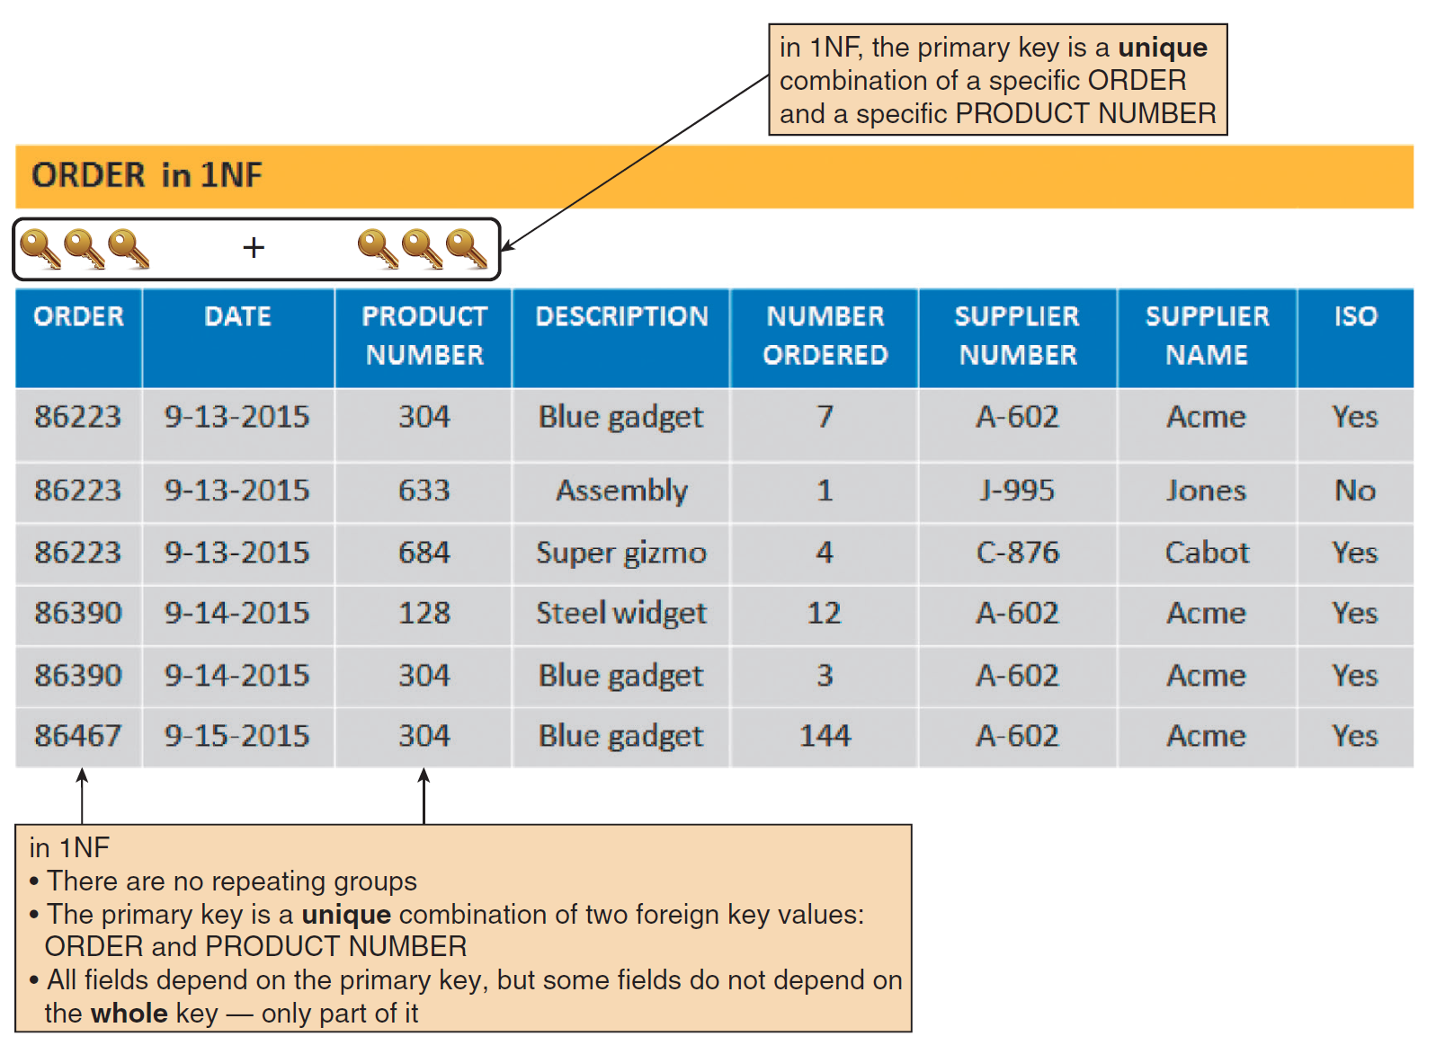
Data Normalization (Cont. 4)
FIGURE 9-21 The ORDER table as it appears in 1NF. The repeating groups have been eliminated. Notice that the repeating group for order 86223 has become three separate records, and the repeating group for order 86390 has become two separate records. The 1NF primary key is a combination of ORDER and PRODUCT NUMBER, which uniquely identifies each record.
Copyright ©2017 Cengage Learning. All Rights Reserved. May not be scanned, copied or duplicated, or posted to a publicly accessible website, in whole or in part.

Slide 31
Data Normalization (Cont. 5)
Second Normal Form (2NF)
Examples of functional dependence
Field A is functionally dependent on Field B if the value of Field A depends on Field B
A table design is in 2NF if:
It is in 1NF
All fields not part of the primary key are functionally dependent on the entire primary key
Copyright ©2017 Cengage Learning. All Rights Reserved. May not be scanned, copied or duplicated, or posted to a publicly accessible website, in whole or in part.

Slide 32
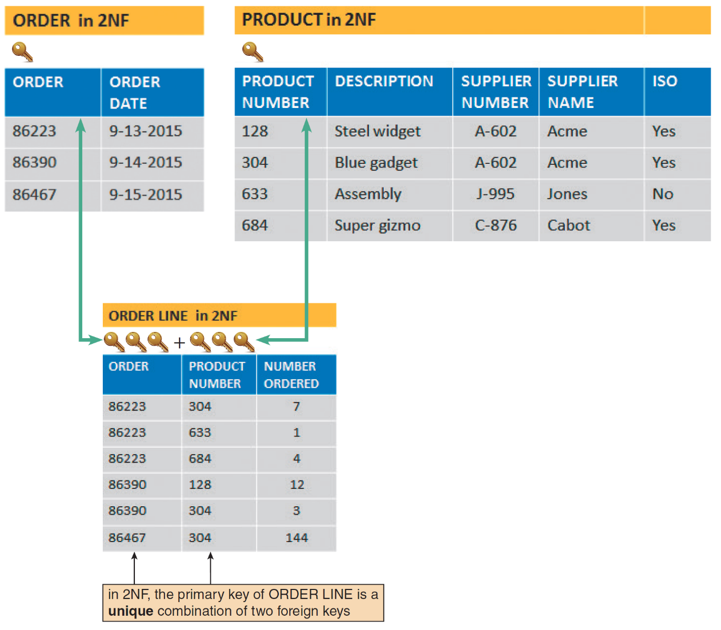
Data Normalization (Cont. 6)
FIGURE 9-22 ORDER, PRODUCT, and ORDER LINE tables in 2NF. All fields are functionally dependent on the primary key.
Copyright ©2017 Cengage Learning. All Rights Reserved. May not be scanned, copied or duplicated, or posted to a publicly accessible website, in whole or in part.

Slide 33
Data Normalization (Cont. 7)
Third Normal Form (3NF)
A design is in 3NF if it is in 2NF and if no nonkey field is dependent on another nonkey field
Avoids redundancy and data integrity problems that still can exist in 2NF designs
Copyright ©2017 Cengage Learning. All Rights Reserved. May not be scanned, copied or duplicated, or posted to a publicly accessible website, in whole or in part.

Slide 34
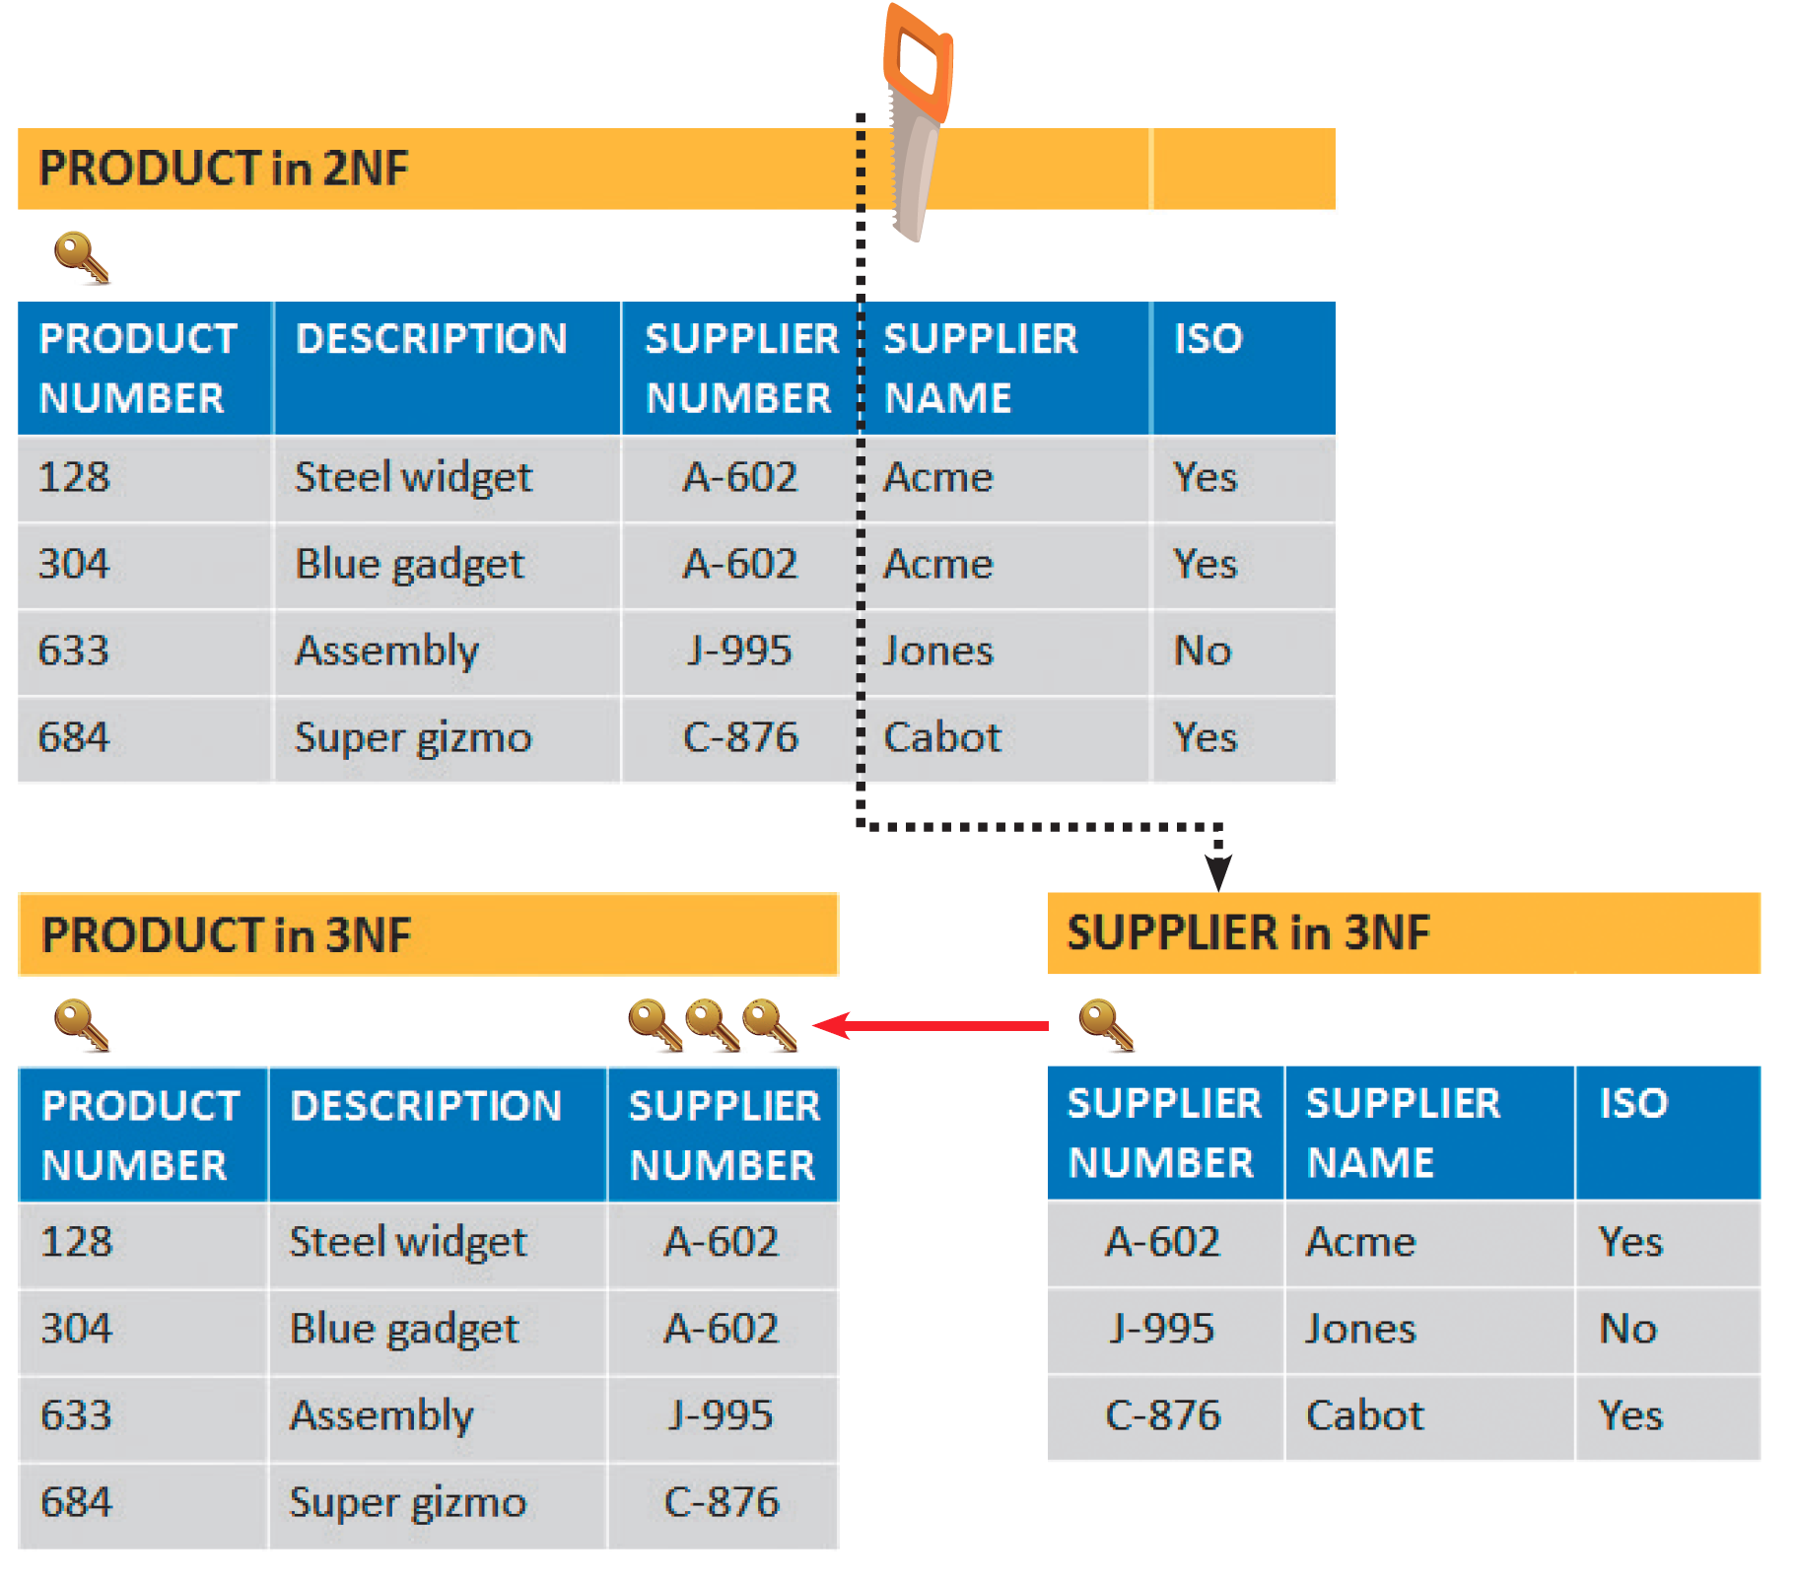
Data Normalization (Cont. 8)
FIGURE 9-23 When the PRODUCT table is transformed from 2NF to 3F, the result is two separate tables:
PRODUCT and SUPPLIER. Note that in 3NF, all fields depend on the key, the whole key, and nothing but the key!
Copyright ©2017 Cengage Learning. All Rights Reserved. May not be scanned, copied or duplicated, or posted to a publicly accessible website, in whole or in part.

Slide 35
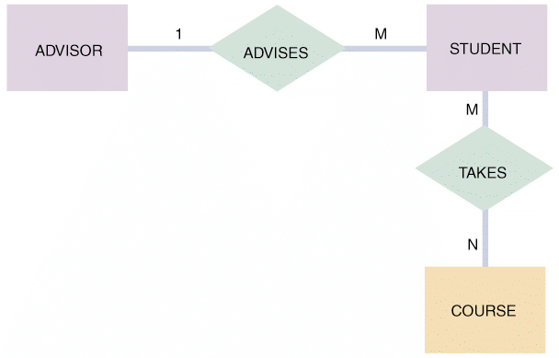
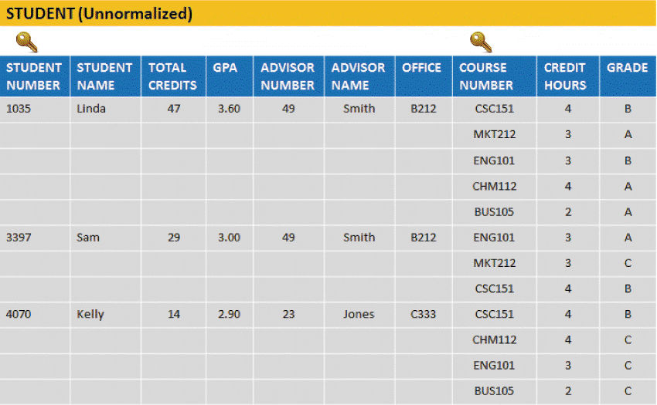
Two Real-World Examples
Crossroads College
FIGURE 9-25 An initial entity-relationship diagram for ADVISOR,
STUDENT, and COURSE.
FIGURE 9-26 The STUDENT table is unnormalized because it contains a repeating group that represents the courses each student has taken.
Copyright ©2017 Cengage Learning. All Rights Reserved. May not be scanned, copied or duplicated, or posted to a publicly accessible website, in whole or in part.

Slide 36
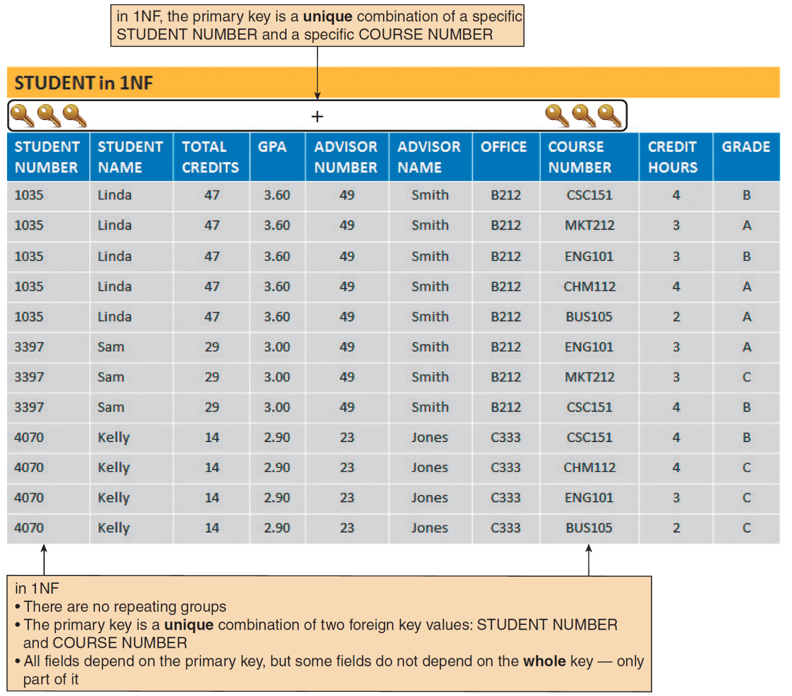
Two Real-World Examples (Cont. 1)
FIGURE 9-27 The STUDENT table in 1NF. Notice that the primary key has been expanded to include STUDENT NUMBER and COURSE NUMBER.
Copyright ©2017 Cengage Learning. All Rights Reserved. May not be scanned, copied or duplicated, or posted to a publicly accessible website, in whole or in part.

Slide 37
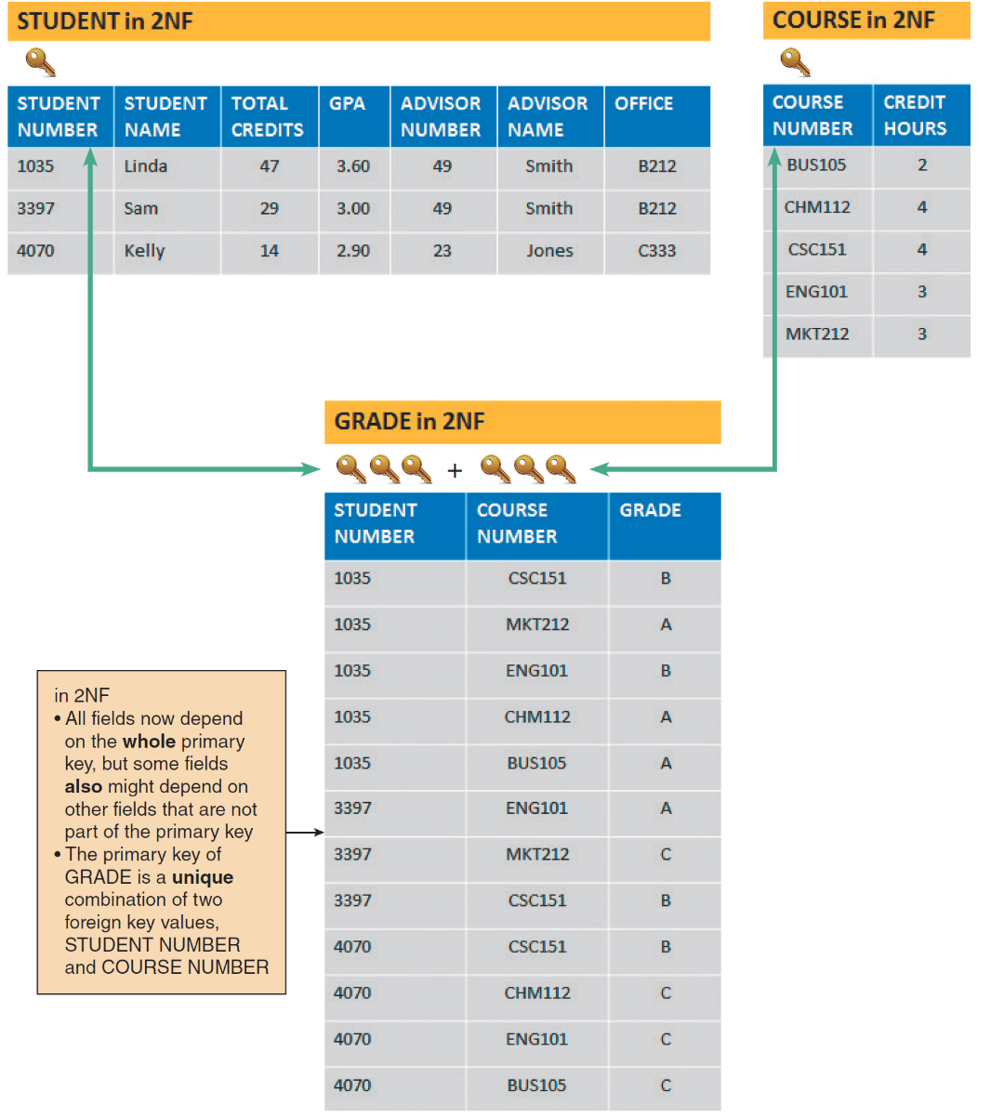
Two Real-World Examples (Cont. 2)
FIGURE 9-28 The STUDENT, COURSE, and GRADE tables in 2NF. Notice that all fields are functionally dependent on the entire primary key of their respective tables.
Copyright ©2017 Cengage Learning. All Rights Reserved. May not be scanned, copied or duplicated, or posted to a publicly accessible website, in whole or in part.

Slide 38
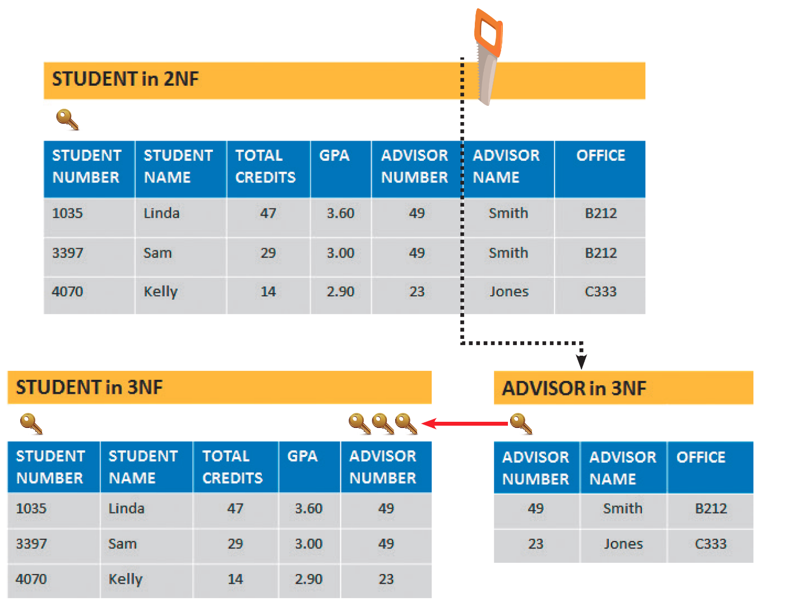
Two Real-World Examples (Cont. 3)
FIGURE 9-29 STUDENT, ADVISOR, COURSE, and GRADE tables in 3NF. When the STUDENT table is
transformed from 2NF to 3NF, the result is two tables: STUDENT and ADVISOR.
Copyright ©2017 Cengage Learning. All Rights Reserved. May not be scanned, copied or duplicated, or posted to a publicly accessible website, in whole or in part.

Slide 39
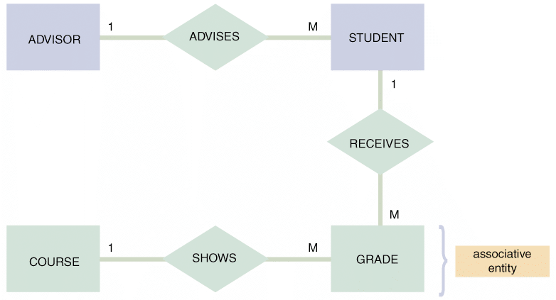
Two Real-World Examples (Cont. 4)
FIGURE 9-30 The entity-relationship diagram for STUDENT, ADVISOR, and COURSE after normalization. The GRADE entity was identified during the normalization process. GRADE is an associative entity that links the STUDENT and COURSE tables.
Copyright ©2017 Cengage Learning. All Rights Reserved. May not be scanned, copied or duplicated, or posted to a publicly accessible website, in whole or in part.

Slide 40
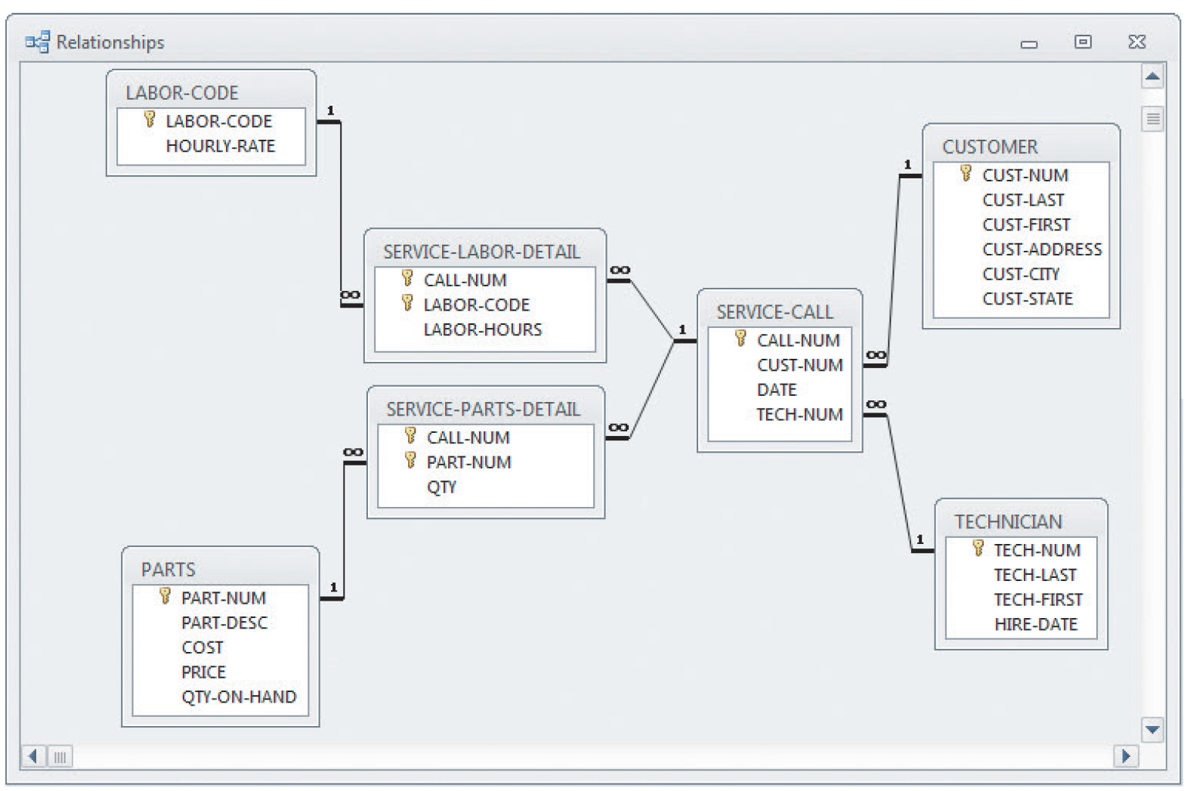
Two Real-World Examples (Cont. 5)
Example 2: Magic Maintenance
FIGURE 9-31 A relational database design for a computer service company uses common fields to link the tables and form an overall data structure. Notice the one-to-many notation symbols, and the primary keys, which are indicated with gold-colored key symbols.
Copyright ©2017 Cengage Learning. All Rights Reserved. May not be scanned, copied or duplicated, or posted to a publicly accessible website, in whole or in part.

Slide 41
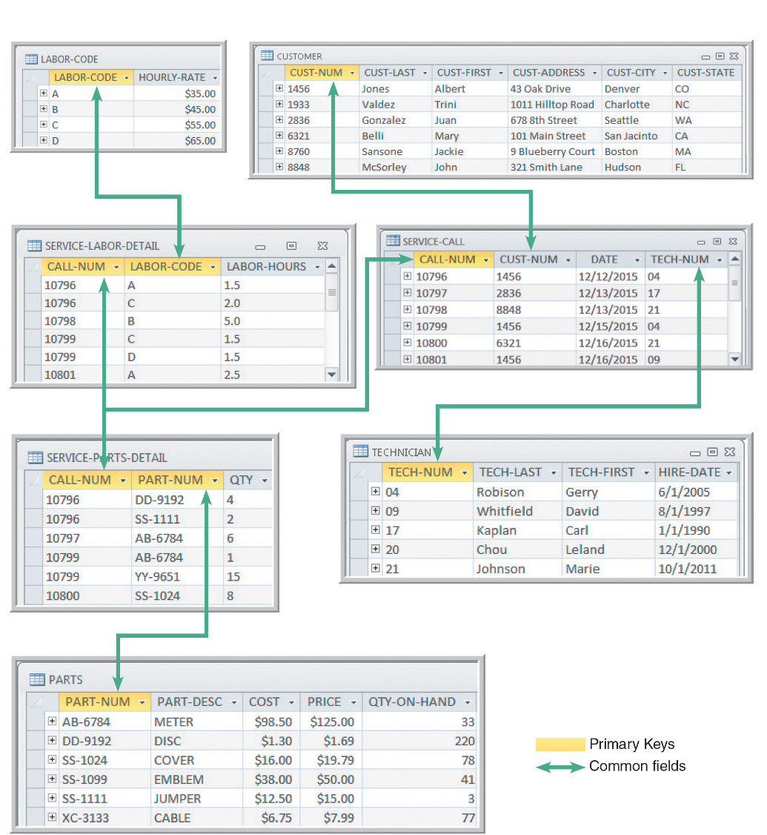
Two Real-World Examples (Cont. 6)
FIGURE 9-32 Sample data, primary keys, and common fields for the database shown in Figure 9-31.
The design is in 3NF. Notice that all nonkey fields functionally depend on a primary key, the whole primary key, and nothing but the primary key.
Copyright ©2017 Cengage Learning. All Rights Reserved. May not be scanned, copied or duplicated, or posted to a publicly accessible website, in whole or in part.

Slide 42
Using Codes
Overview of Codes
Codes are shorter than the data they represent
Save storage space and costs
Decrease data entry time and transmission time
Codes can:
Reveal or conceal information
Reduce data input errors
Coded data is easier to remember
Copyright ©2017 Cengage Learning. All Rights Reserved. May not be scanned, copied or duplicated, or posted to a publicly accessible website, in whole or in part.

Slide 43
Using Codes (Cont. 1)
Types of Codes
Sequence codes: Numbers or letters assigned in a specific order
Contain no additional information other than an indication of order of entry into the system
Block sequence codes: Use blocks of numbers for different classifications
Sequence of numbers in a particular block can have additional meaning
Significant digit codes: Distinguish items by using a series of subgroups of digits
Copyright ©2017 Cengage Learning. All Rights Reserved. May not be scanned, copied or duplicated, or posted to a publicly accessible website, in whole or in part.

Slide 44
Using Codes (Cont. 2)
Alphabetic codes: Use letters to distinguish one item from another
Category codes: Identify a group of related items
Abbreviation codes: Alphabetic abbreviations
Mnemonic codes: Use specific combination of letters that are easy to remember
Derivation codes: Combine data from different item attributes, or characteristics
Cipher codes: Use a keyword to encode a number
Action codes: Indicate what action is to be taken with an associated item
Copyright ©2017 Cengage Learning. All Rights Reserved. May not be scanned, copied or duplicated, or posted to a publicly accessible website, in whole or in part.

Slide 45

Using Codes (Cont. 3)
FIGURE 9-34 Abbreviations for some of the world’s busiest airports.
BLANKartist/Shutterstock.com
Copyright ©2017 Cengage Learning. All Rights Reserved. May not be scanned, copied or duplicated, or posted to a publicly accessible website, in whole or in part.

Slide 46
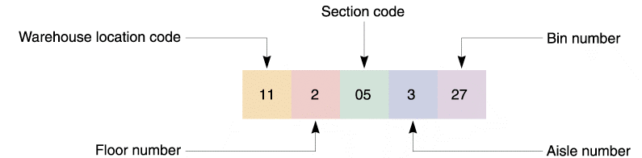
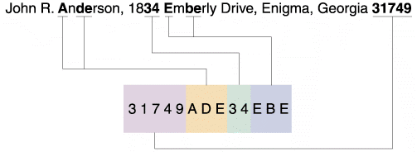
Using Codes (Cont. 4)
FIGURE 9-35 Sample of a code that uses significant digits to pinpoint the location of an inventory item.
FIGURE 9-36 A magazine subscriber code is derived from various parts of the name and address.
Copyright ©2017 Cengage Learning. All Rights Reserved. May not be scanned, copied or duplicated, or posted to a publicly accessible website, in whole or in part.

Slide 47
Using Codes (Cont. 5)
Designing Codes
Keep codes concise
Allow for expansion
Keep codes stable
Make codes unique
Use sortable codes
Use a simple structure
Avoid confusion
Make codes meaningful
Use a code for a single purpose
Keep codes consistent
Copyright ©2017 Cengage Learning. All Rights Reserved. May not be scanned, copied or duplicated, or posted to a publicly accessible website, in whole or in part.

Slide 48
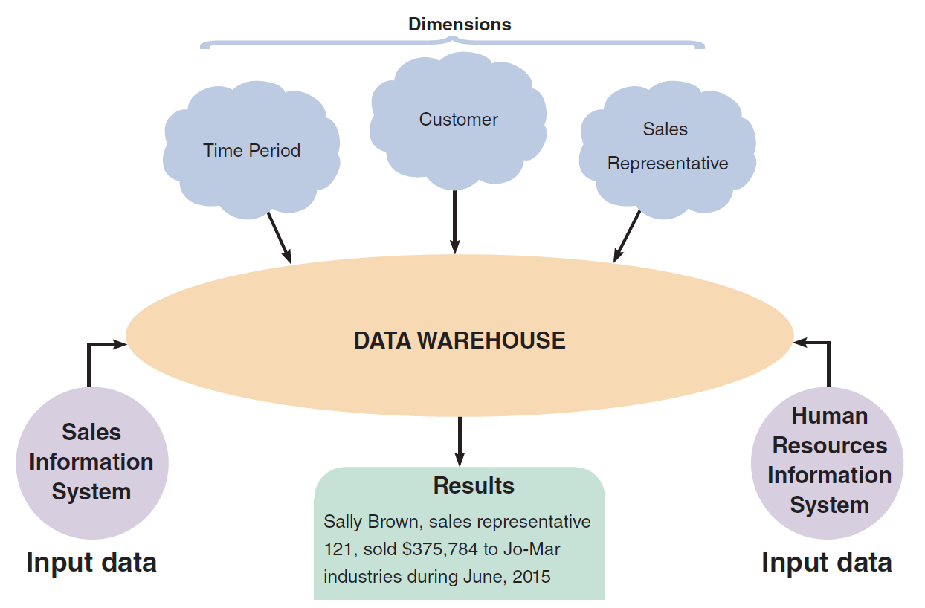
Data Storage and Access
Tools and Techniques
Data warehouse
An integrated collection of data that can include seemingly unrelated information, no matter where it is stored in the company
Data mart
Designed to serve the needs of a specific department
FIGURE 9-37 A data warehouse stores data from several systems. By selecting data dimensions, a user can retrieve specific information without having to know how or where the data is stored.
Copyright ©2017 Cengage Learning. All Rights Reserved. May not be scanned, copied or duplicated, or posted to a publicly accessible website, in whole or in part.

Slide 49
Data Storage and Access (Cont. 1)
Data Mining (clickstream storage)
Looks for meaningful data patterns and relationships
Suggested goals for data mining
Increase the number of pages viewed per session and referred customers
Reduce clicks to close
Increase checkouts per visit and average profit per checkout
Can be used to build a profile of new customers
Copyright ©2017 Cengage Learning. All Rights Reserved. May not be scanned, copied or duplicated, or posted to a publicly accessible website, in whole or in part.

Slide 50
Data Storage and Access (Cont. 2)
Logical versus Physical Storage
Logical storage: Data that a user can view, understand, and access, regardless of how or where that information actually is organized or stored
Physical storage: Strictly hardware-related
Involves the process of reading and writing binary data to physical media
Copyright ©2017 Cengage Learning. All Rights Reserved. May not be scanned, copied or duplicated, or posted to a publicly accessible website, in whole or in part.

Slide 51
Data Storage and Access (Cont. 3)
Data Coding
EBCDIC (Extended Binary Coded Decimal Interchange Code)
Used on mainframe computers and high-capacity servers
ASCII (American Standard Code for Information Interchange)
Used on most personal computers
Binary storage format
Represents numbers as actual binary values
Unicode: Uses two bytes per character
Copyright ©2017 Cengage Learning. All Rights Reserved. May not be scanned, copied or duplicated, or posted to a publicly accessible website, in whole or in part.

Slide 52
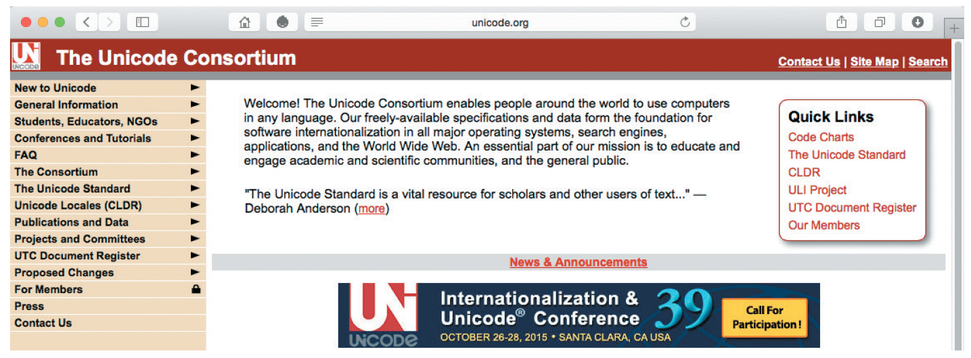
Data Storage and Access (Cont. 4)
FIGURE 9-38 Unicode is an international coding format that represents characters as integers, using 16 bits per character. The Unicode Consortium maintains standards and support for Unicode.
©1991–2015 Unicode, Inc.
Copyright ©2017 Cengage Learning. All Rights Reserved. May not be scanned, copied or duplicated, or posted to a publicly accessible website, in whole or in part.

Slide 53
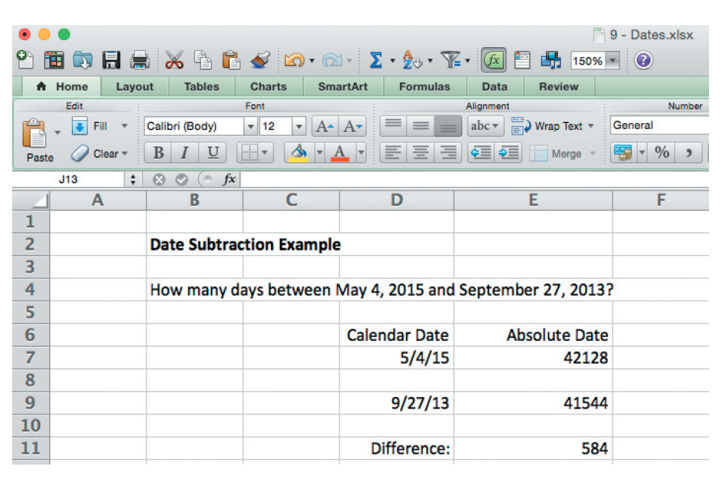
Data Storage and Access (Cont. 5)
Storing dates
International Organization for Standardization (ISO) requires a format of four digits for the year, two for the month, and two for the day (YYYYMMDD)
Absolute date: Total number of days from some specific base date
FIGURE 9-39 Microsoft Excel uses absolute dates in calculations. In this example, May 4, 2015, is displayed as 42128, and September 27, 2013, is displayed as 415443. The difference between the dates is 584 days.
Copyright ©2017 Cengage Learning. All Rights Reserved. May not be scanned, copied or duplicated, or posted to a publicly accessible website, in whole or in part.

Slide 54
Data Control
A well-designed DBMS must provide built-in control and security features
Forms of data protection
Providing limited access to files and databases
Use of user ID and password, permissions and encryption
Backup copies of databases must be retained for a specified period of time
Recovery procedures can be used to restore the file or database
Maintain audit log files and audit fields
Copyright ©2017 Cengage Learning. All Rights Reserved. May not be scanned, copied or duplicated, or posted to a publicly accessible website, in whole or in part.

Slide 55
Chapter Summary
A database consists of linked tables that form an overall data structure
DBMS enable users to add, update, manage, access, and analyze data in a database
DBMS designs are more powerful and flexible than traditional file-oriented systems
Components include interfaces for users, database administrators, and related systems
In an information system, an entity is a person, place, thing, or event for which data is collected and maintained
Copyright ©2017 Cengage Learning. All Rights Reserved. May not be scanned, copied or duplicated, or posted to a publicly accessible website, in whole or in part.

Slide 56
Chapter Summary (Cont. 1)
Key fields include primary keys, candidate keys, foreign keys, and secondary keys
An entity-relationship diagram (ERD) is a graphic representation of all system entities and the relationships among them
Relationship between two entities is referred to as cardinality
Normalization is a process for avoiding problems in data design
A code is a set of letters or numbers used to represent data in a system
Copyright ©2017 Cengage Learning. All Rights Reserved. May not be scanned, copied or duplicated, or posted to a publicly accessible website, in whole or in part.

Slide 57
Chapter Summary (Cont. 2)
Logical storage is information seen through a user’s eyes, regardless of how or where that information actually is organized or stored
File and database control measures include limiting access to the data, data encryption, backup/recovery procedures, audit-trail files, and internal audit fields
Copyright ©2017 Cengage Learning. All Rights Reserved. May not be scanned, copied or duplicated, or posted to a publicly accessible website, in whole or in part.

